Slide 1

Session 1 – Arduino Basics
INTRODUCING THE ARDUINO PLATFORM AND BASIC PROGRAMMING CONSTRUCTS

Slide 2
Course Structure
9th October (Today) – Session 1: Arduino Basics
Introducing the Arduino platform and basic programming constructs
16st October – Session 2: Using Inputs
How to input signals into an Arduino and use them in code
23rd October – Session 3: Serial Communication
Using Serial Protocols – UART, I2C, SPI – to communicate with the Arduino
30th October – Session 4: EEPROM and Interrupts
Expanding the functionality of the Arduino using hardware utilities
6th November – Session 5

Slide 3
Course Requirements & Assumptions
A Laptop with Arduino IDE installed
Windows, MacOS and Linux versions available at:
http://arduino.cc/en/Main/Software
(Windows version may require administrator access to install drivers)
We’ll teach the necessary programming constructs as we go along
Just ask if you need help!

Slide 4
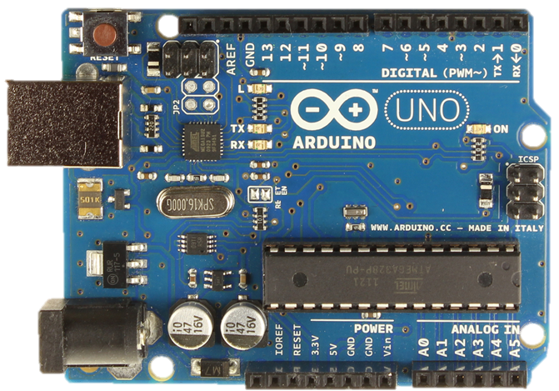
What is an Arduino?
Arduino UNO Features:
14 Digital I/O Pins
6 Analogue Inputs
6 PWM pins
USB Serial
16MHz Clock Speed
32kB Flash Memory
2kB SRAM
1kB EEPROM

Slide 5
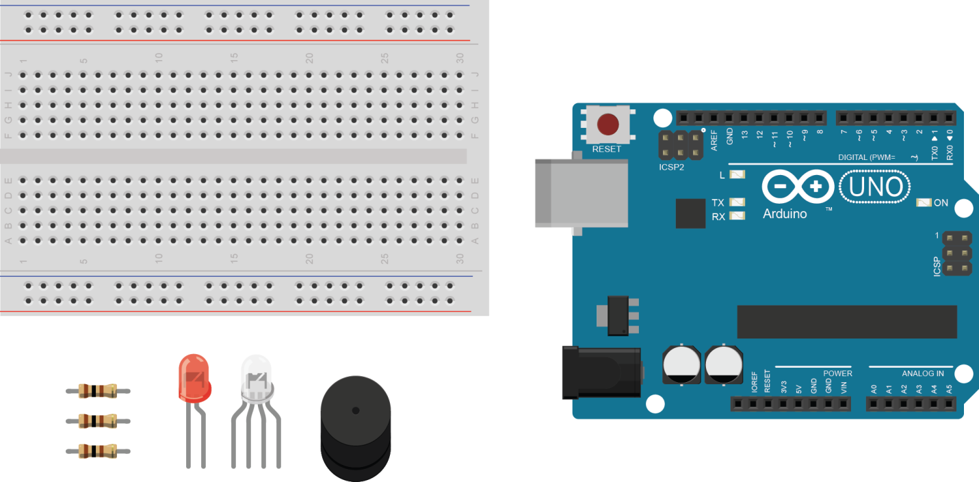
Kit Contents
1x Arduino UNO
1x Breadboard
1x USB Cable
3x 100R Resistor
1x LED
1x RGB LED
Some Jumper Leads

Slide 6
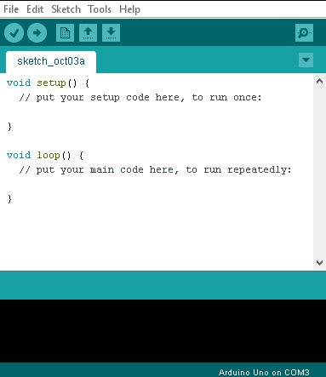
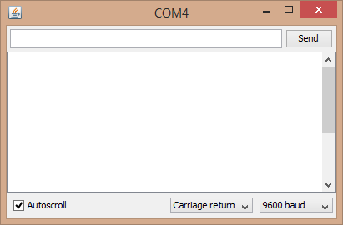
The Arduino IDE
Verify – checks the code syntax for errors
Serial Monitor – opens a window used for communication with the Arduino
Upload – verifies and uploads code to a connected Arduino
Info Panel – shows errors when compiling and uploading programs
Code Area – where code is written

Slide 7
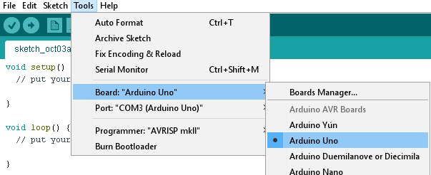
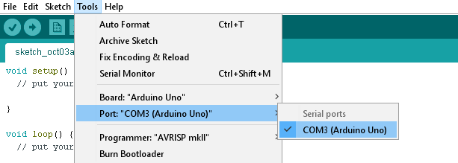
Connecting to the Arduino
Connect the Arduino via USB
Select the “Arduino UNO” board type
Select the right COM port
Try opening the Serial Monitor to see if it worked

Slide 8
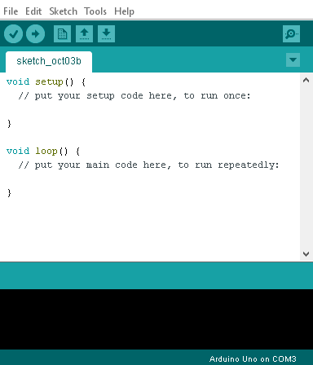
Arduino Sketches
setup() – a function to contain code to execute once at start-up or when reset
loop() – a function that runs repeatedly and contains the main program
void – don’t worry about this, we’ll get to it later
Lines starting with // are comments and can be ignored
Code goes between the curly brackets in each function
(Arduino code is written in the C programming language)

Slide 9
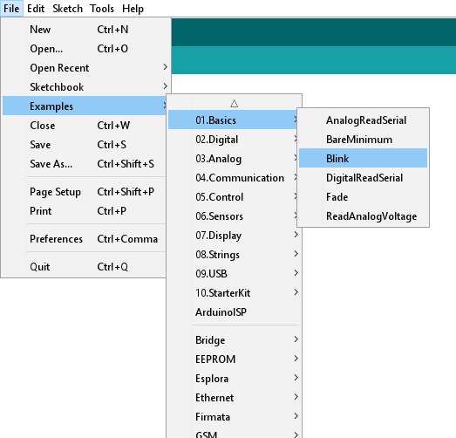
IDE Code Examples
The IDE contains a vast library of example programs
These demonstrate all the IDE’s features
Arduino shields and libraries usually also come with example code
If these examples don’t cover what you need – Google it!
Try finding and opening the “Blink” example code

Slide 10
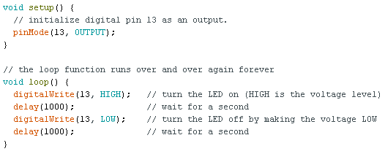
Blink
Makes the built-in LED on pin 13 blink!
Note the following:
pinMode function
digitalWrite function
Delay function (milliseconds)
Lines ending with “;”

Slide 11
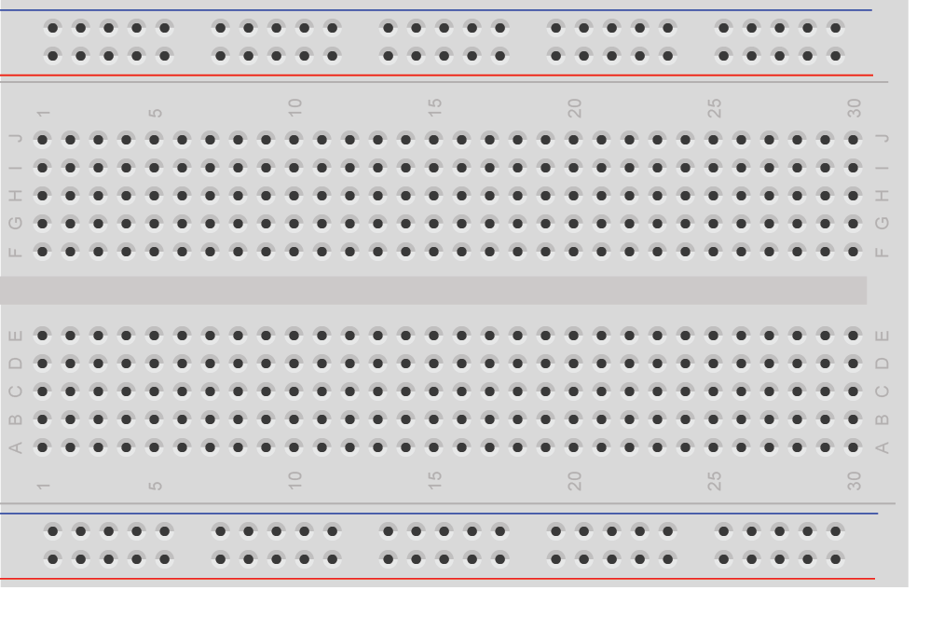
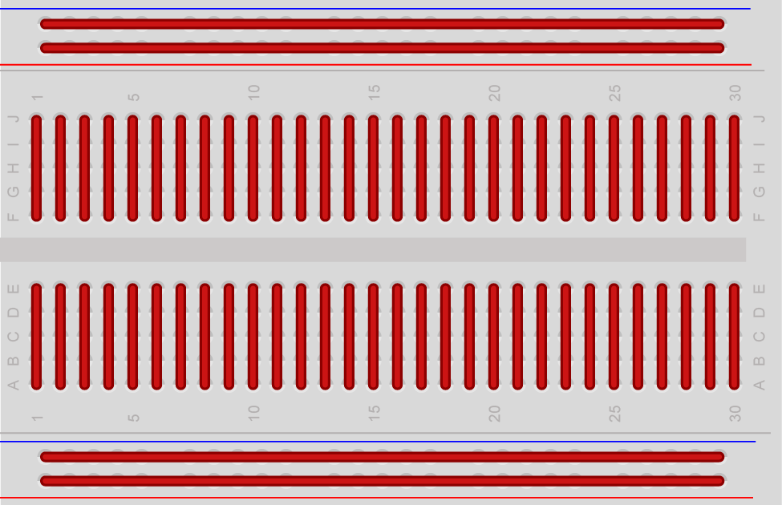
Breadboards

Slide 12
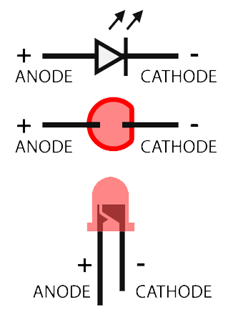

LEDs

Slide 13
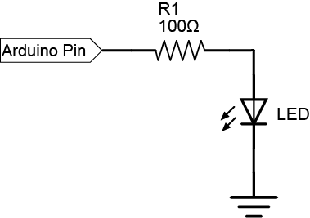
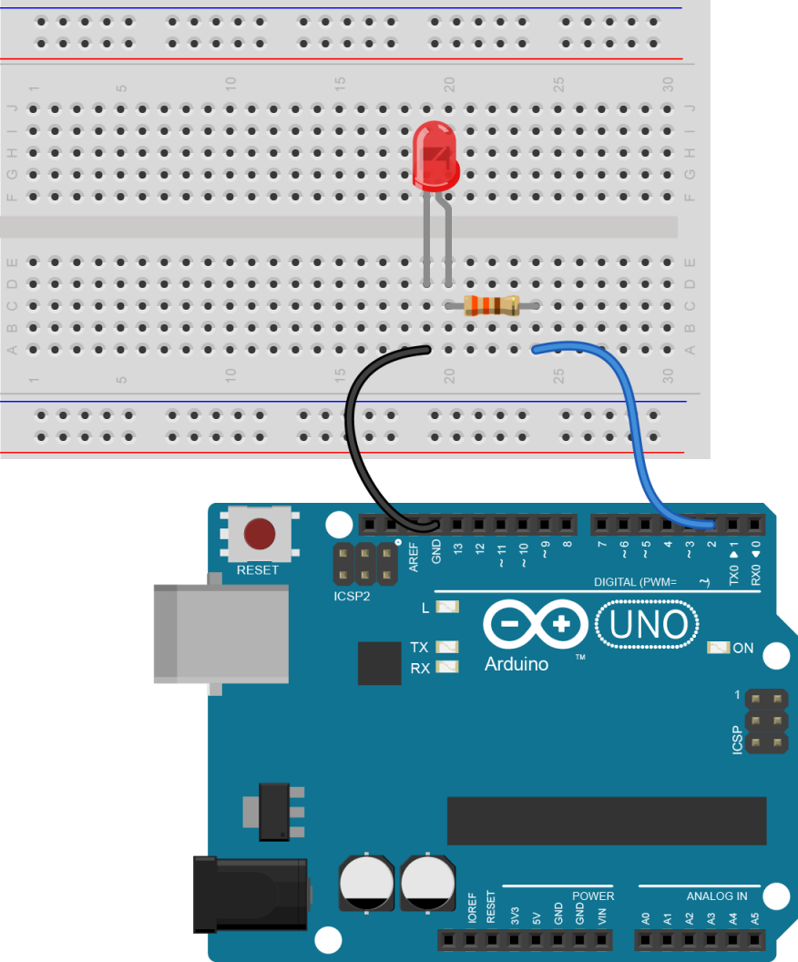
Connecting External LEDs
Connect an LED to Pin 13 and see if it blinks
Connect the LED to a different pin and make it blink
Try making multiple LEDs blink alternately!

Slide 14
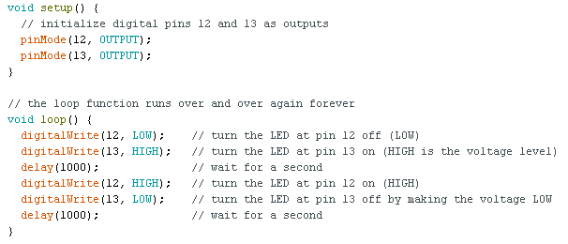
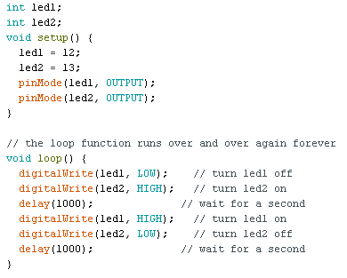
Connecting External LEDs - Examples

Slide 15
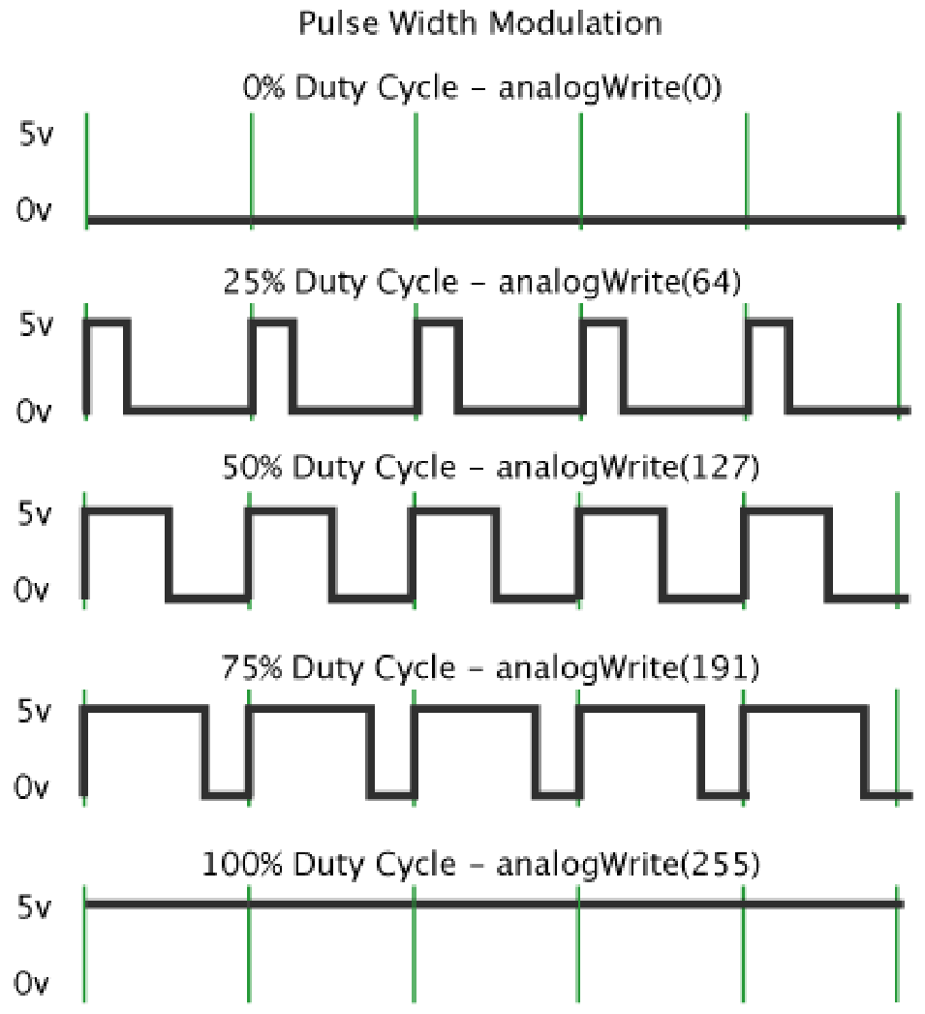
PWM – Controlling LED Brightness
PWM stands for Pulse Width Modulation
Allows you to make “fake” analogue signals
Changing time a pin spends high and low affects the average voltage
Average voltage affects the LED brightness!
So long the PWM frequency is faster than the eye can see (~25Hz) the LED looks constantly on...
Arduino UNO can only do PWM on pins 3, 5, 6, 9, 10 & 11

Slide 16
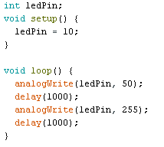
PWM Implementation
PWM is implemented using the analogWrite function – analogWrite(pin, value)
The PWM value can be between 0 (off) and 255 (on)
PWM doesn’t need a pinMode
Note the use of a variable to represent Pin 10
Try this with your LED – remember only pins 3, 5, 6, 9, 10 & 11 will work!
Try making the LED get brighter in steps

Slide 17
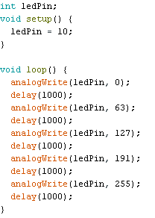
PWM Example
The LED gets brighter in steps
At each step the PWM value gets larger and the LED gets brighter
The more steps you add the smoother the LED gets brighter
What if we could do this easier – with loops?

Slide 18
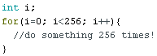
For Loops
Repeats its content for as long as the loop condition is satisfied
Start condition is set up at the start of the loop
Iterative operation is applied at the end of each iteration
i++ - increment i by 1
So this will do whatever is inside it 256 times
The value of i increases with each iteration
Can you make an LED get brighter over time using a for loop?
Start Condition
Loop Condition
Iterative Operation

Slide 19
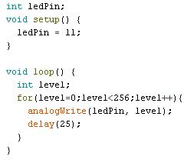
For Loops Example
For loop makes the LED get brighter from fully off to fully on
Note how high values of level make little difference to the observed brightness
Could we do this another way?

Slide 20
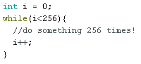
While Loops
Repeats its content while the given statement is still true
In this context we are using a while loop to behave as a for loop, applying i++ as an iterative operation and specifying i as a start condition
These are not essential for a while loop!
Try implementing the previous code in a while loop
(Start Condition)
Loop Condition
(Iterative Operation)

Slide 21
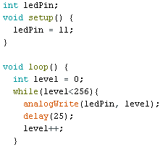
While Loops Example
Level increases with each iteration so long as the loop condition is true
When level = 256 the loop will exit and the code will continue
Think how you could make the while loop run by decreasing level – try using the decrement function, level--

Slide 22
Plenary
Output through digital pins:
Set up using pinMode(pin, OUTPUT);
Set by digitalWrite(pin, state);
PWM pins (3, 5, 6, 9, 10, 11):
Have a level between 0 and 255, corresponding to a voltage between 0V and 5V
Set by analogWrite(pin, level);
For loops: for(start; condition; iterative){ }
While loops: while(condition){ }
Millisecond delays: delay(ms);
Defining integer variables: int x;
Incrementing variables: x++;
Decrementing variables: x--;

Slide 23
Final Challenges
Try some of the following:
Make a LED fade on and off repeatedly
Make an RGB LED cycle through the 7 possible colours
Make an RGB LED fade between red, green and blue
Make two LEDs fade alternately
Make an LED chain where the LEDs fade and “chase” one another

